Slide 1
Playlist: OOP in C++ - Object Oriented Programming YouTube Channel: MyLegacy in Programming (Eman)
Class Relations
Composition - Aggregation - Association
Eman Hosam

Slide 2
Agenda
Logical Meaning
Class Relations: Single Variable
Class Relations: Array Variable

Slide 3
Logical Meaning
Class Relations

Slide 4
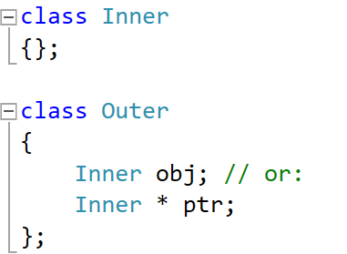
Logical Meaning of Class Relations
Composition: (has-a relationship)
When the outer class object is destructed, the inner class object must be destructed (automatic/static allocation inside the outer class)
Very Strong Relationship (Example: Car and CarBody)
Aggregation: (has-a relationship)
When the outer class object is destructed, the inner class object may be destructed (dynamic allocation inside the outer class)
Strong Relationship (Example: Car and Wheel)
Association: (uses relationship)
When the outer object is destructed, the inner class object is not affected. (no allocation inside the outer class)
Weak Relationship (Example: Car and Driver)

Slide 5
Single Variable
Class Relations

Slide 6
Order of Construction/Destruction
Order of Construction of class X:
Data members of X (in order)
Constructor of Class X itself
Order of Destruction of class X:
Destructor of Class X itself
Data members of X (reverse order)
Notes:
Pointers do NOT call constructors or destructors
Constructors are called: X x1; or new X;
Destructors are called: } or delete pX;
Note: the above order of construction or destruction is the order of body execution not calling.
Obj
Data-member1
Data-member 2

Slide 7
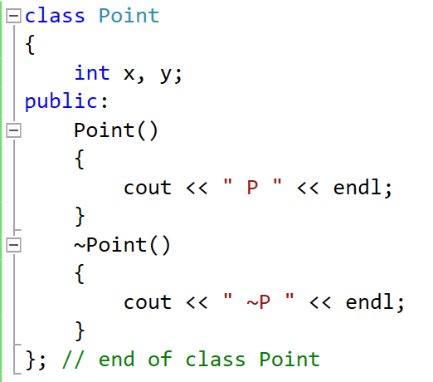
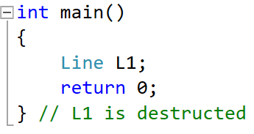
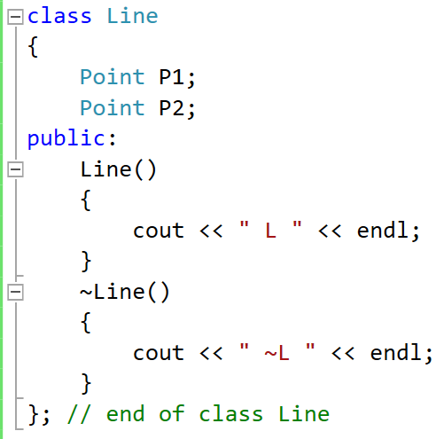
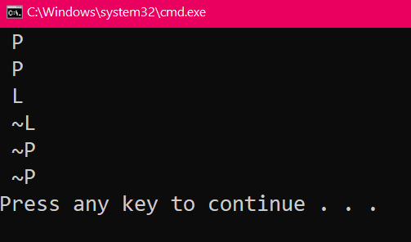
Composition
Line Obj
L1
Point Objs
3
P1
x
y
3
P2
x
y
2
4
Same for P1
2
4
Same for P2
P1 is an Object, so to call a function on it: Dot Operator
P1.func();
1
5
1

Slide 8
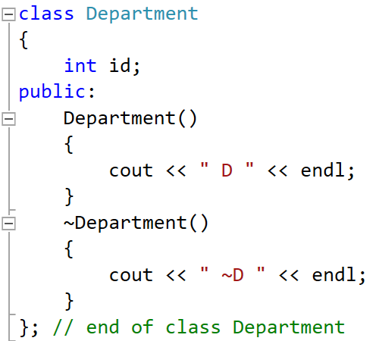
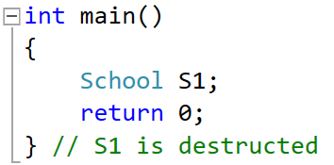
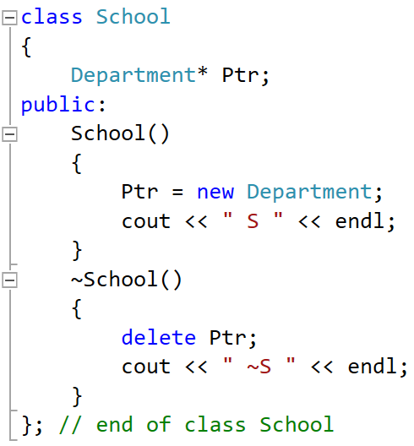
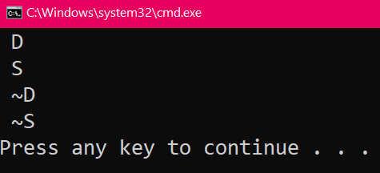
Aggregation
School Obj
4
Dep Obj
S1
Dep Ptr
2
Ptr
id
Heap
Stack
2
4
Note:
Ptr is a Pointer, so to call a function on it: Arrow Operator
P1->func();
1
Note: No constructor/destructor are called for Pointer data members by default ➔ need explicit
new and delete
3
5
1
3
5

Slide 9
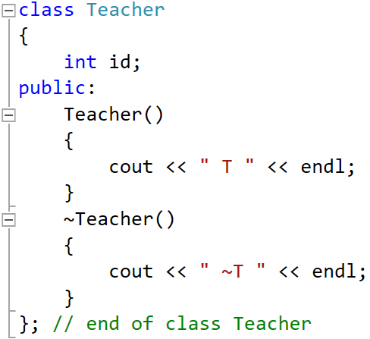
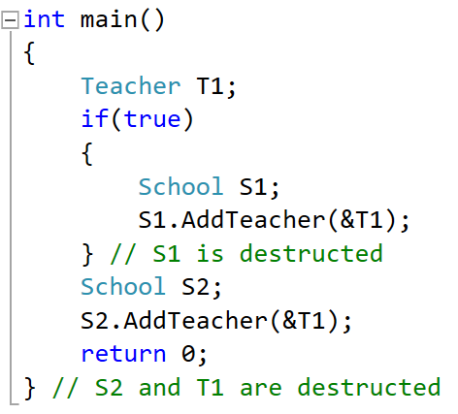
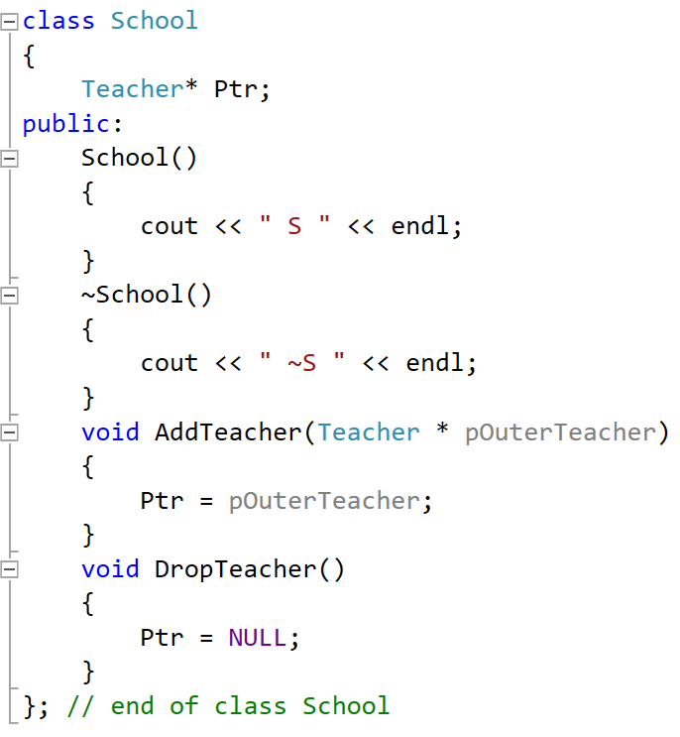
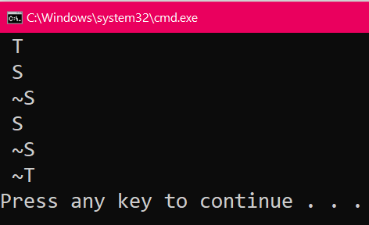
Association
S2
T Ptr
0
Ptr
School Objs
S1
Teacher Obj
2
2
T Ptr
T1
1
Ptr
id
3
Heap
Stack
1
Note:
Ptr is a Pointer, so to call a function on it: Arrow Operator
P1->func();
Note: No constructor/destructor are called for Pointer data members by default.
3

Slide 10
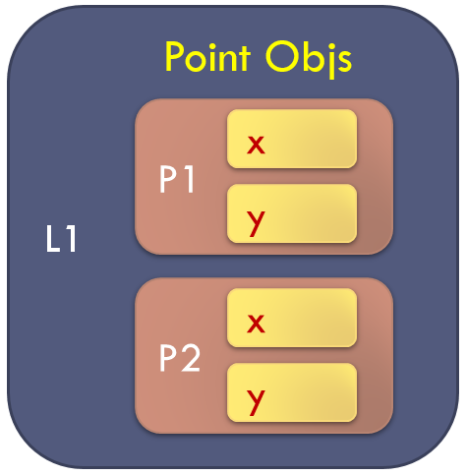
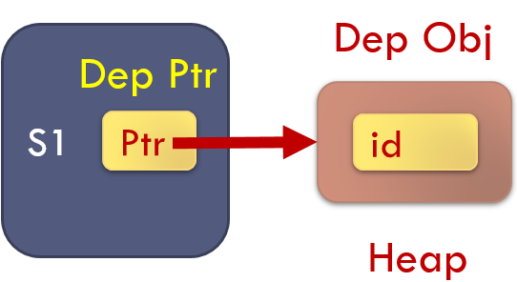
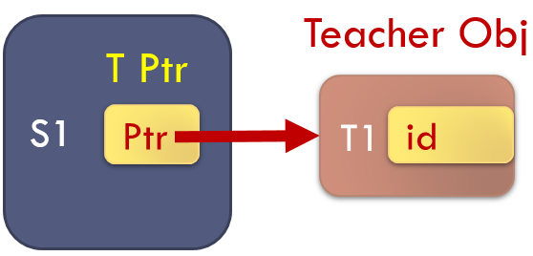
Composition
Aggregation
Association

Slide 11
Comparison
 | Composition | Aggregation | Association
Is the inner class object or pointer inside the outer? | Object To call: Obj.func() | Pointer To call: Ptr->func() | Pointer To call: Ptr->func()
The construction of the inner class object is the responsibility of: | The Outer Class (Automatic/Static Alloc.) | The Outer Class (Dynamic Alloc.) | NOT the Outer Class (e.g., in the main func. Or a third class)
The destruction of the inner class object is the responsibility of: | The Outer Class (Automatic/Static De-alloc.) | Maybe the Outer Class Based on user requirement (Dynamic De-alloc.) | NOT the Outer Class (e.g., in the main func. Or a third class)
Lifetime of the outer and inner class object: | Totally Dependent | Dependent in construction, and maybe also in destruction | Totally Independent
How strong is the relationship? | Very Strong | Strong | Weak

Slide 12
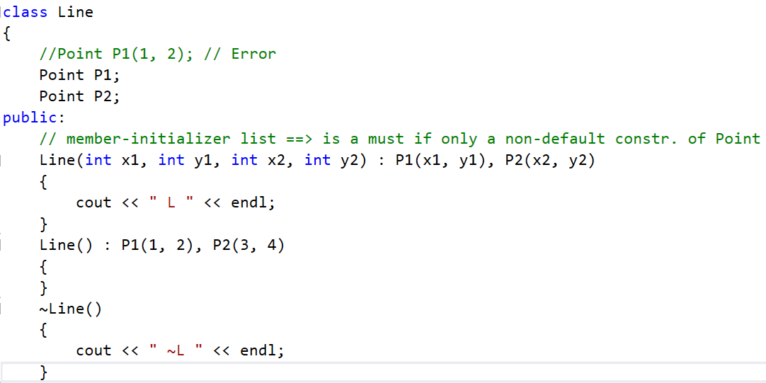
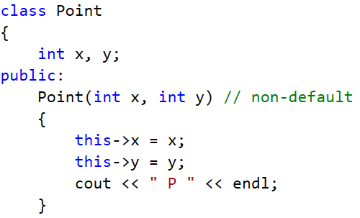
Non-Default Constructor in Composition
If there is ONLY a non-default constructor in the inner class of Composition, Member Initializer List MUST be used to pass the arguments to the non-default constructor.
Composition

Slide 13
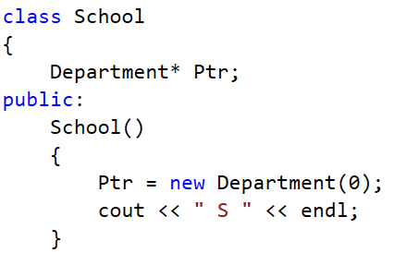
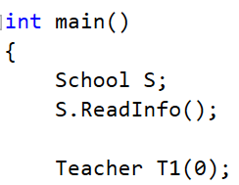
Non-Default Constructor in Aggregation and Association
In Aggregation and Association, we create one object at a time, so pass the arguments when you create it.
Note: In Aggregation, the inner class object is created inside the outer.
However, In Association, the inner class object is created outside the outer.
Aggregation
Association

Slide 14
Array Variable
Class Relations

Slide 15
Review
Array of Objects
[0]
[1]
[2]
[3]
Arr[i] is an Object, so to call a function on it: Dot Operator
Arr[i].func();
Array of Integers
int Arr [4];
Array of Class Objects
Point Arr [4];
Array of Class Pointers
Point * Arr [4];
Arr[0] = new Point;
delete Arr[0];
delete Arr; // Wrong
Arr
x
x
x
x
y
y
y
y
Array of Pointers
Arr[i] is a Pointer, so to call a function on it: Arrow Operator
Arr[i]->func();
[0]
[1]
[2]
[3]
Arr
x
y

Slide 16
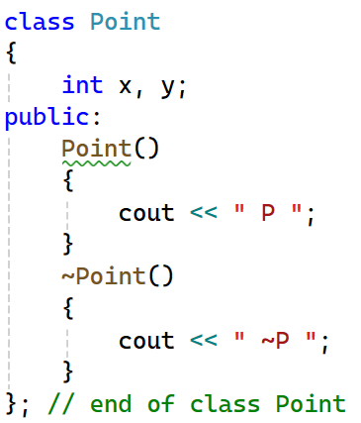
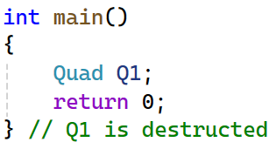
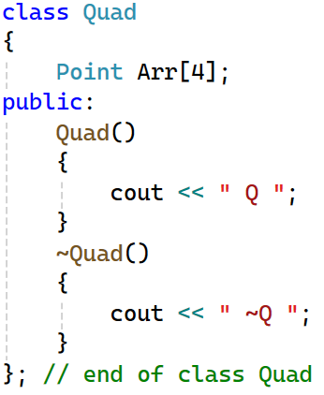
Composition
Q1
3
[0]
[1]
[2]
[3]
4 times
Arr
x
x
x
x
3
y
y
y
y
4 times
in reverse order
2
2
Note:
Arr[i] is an Object, so to call a function on it: Dot Operator
Arr[i].func();
1
4
1

Slide 17
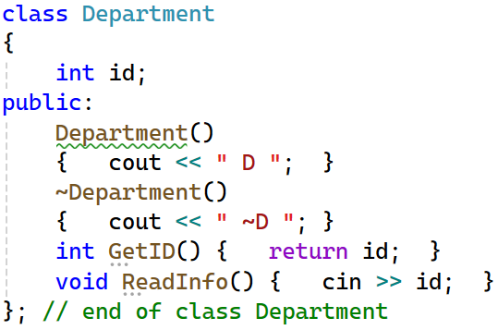
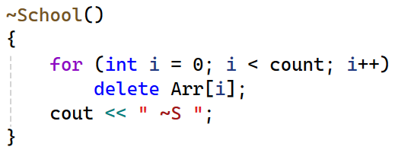
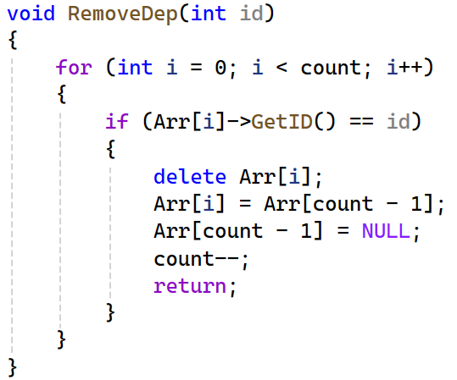
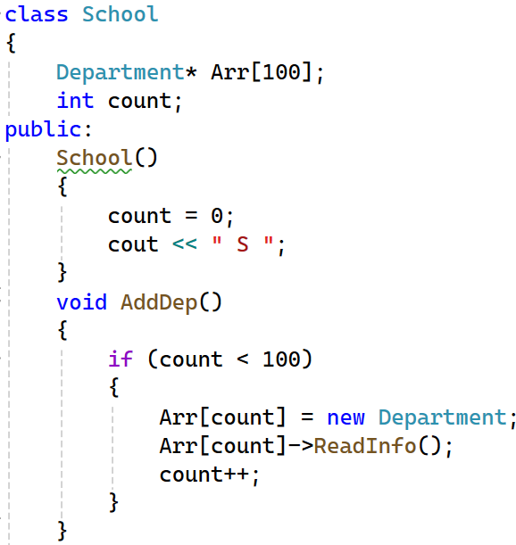
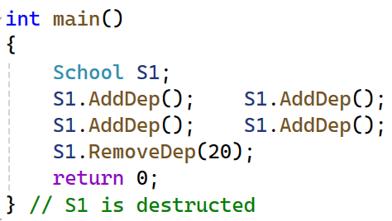

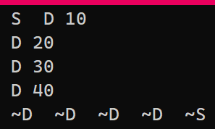
Aggregation
S1
count
4
[0]
[1]
[2]
[3]
[99]
2
1
D destructor is called “count” times
Arr
2
3
10
20
30
40
No D constructors are called
2
4
No more D destructors are called
1
3
Arr[i] is an Pointer, so to call a function on it: Arrow Operator
Arr[i]->func();
1

Slide 18
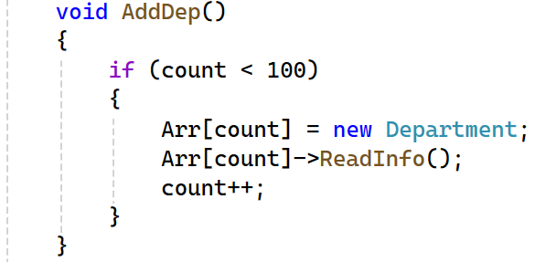

Aggregation: Add Department
count
3
[0]
[1]
[2]
[3]
[99]
Arr
Department constructor is called
10
20
30
1
count
4
2
3
[0]
[1]
[2]
[3]
[99]
Arr
In the main:
10
20
30
40

Slide 19
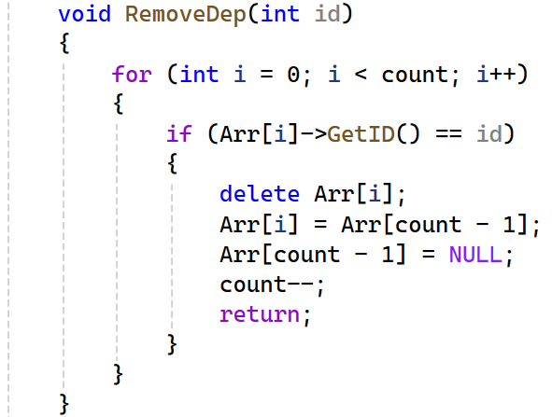

Aggregation: Remove Department
count
4
[0]
[1]
[2]
[3]
[99]
Arr
10
20
30
40
Department destructor is called
1
2
count
3
3
[0]
[1]
[2]
[3]
[99]
4
Arr
In the main:
10
30
20
40

Slide 20
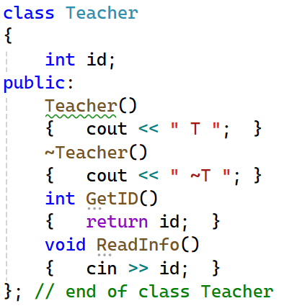
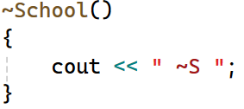
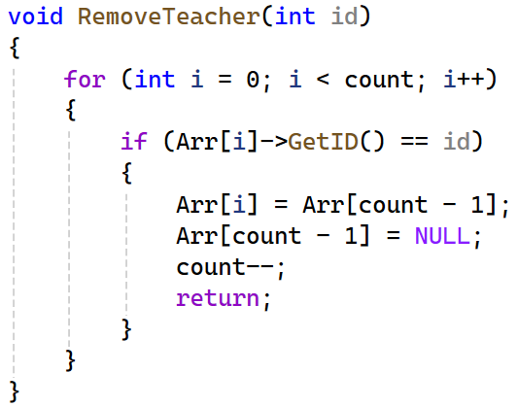
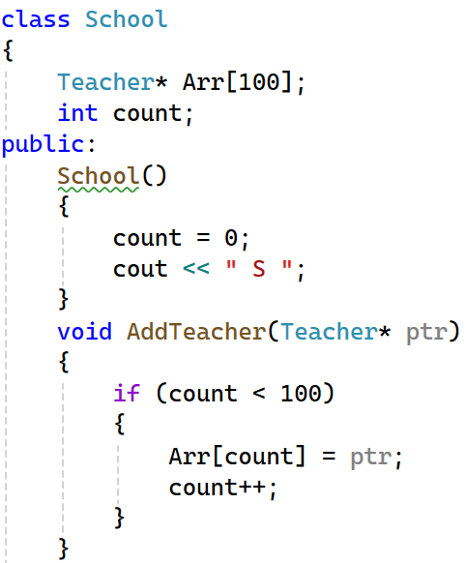
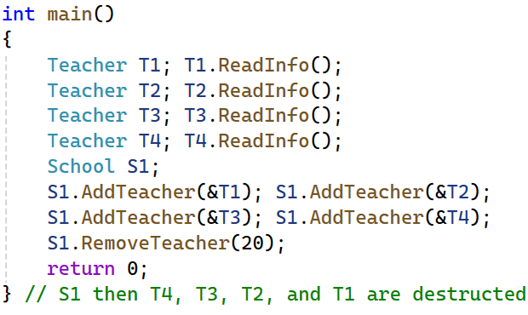
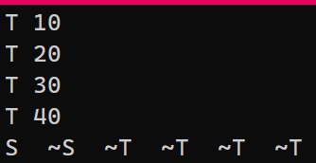

Association
S1
count
4
[0]
[1]
[2]
[3]
[99]
1
Arr
10
20
30
40
No T constructors are called
2
2
No T destructors are called
1
3
Arr[i] is an Pointer, so to call a function on it: Arrow Operator
Arr[i]->func();

Slide 21
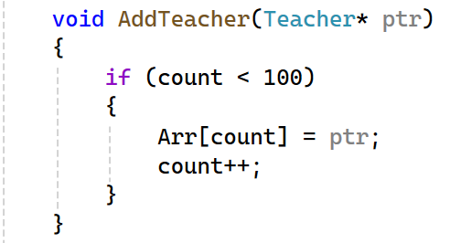

Association: Add Teacher
ptr
count
3
T4
40
[0]
[1]
[2]
[3]
[99]
Arr
10
20
30
Note: No Teacher constructors are called
count
4
1
2
[0]
[1]
[2]
[3]
[99]
Arr
In the main:
10
20
30
T4
40

Slide 22

Association: Remove Teacher
count
4
[0]
[1]
[2]
[3]
[99]
Arr
10
20
30
40
Note: No Teacher destructors are called
1
count
3
2
3
[0]
[1]
[2]
[3]
[99]
Arr
In the main:
10
30
Element 20 is Still Alive
But no referred to by the array
20
40

Slide 23
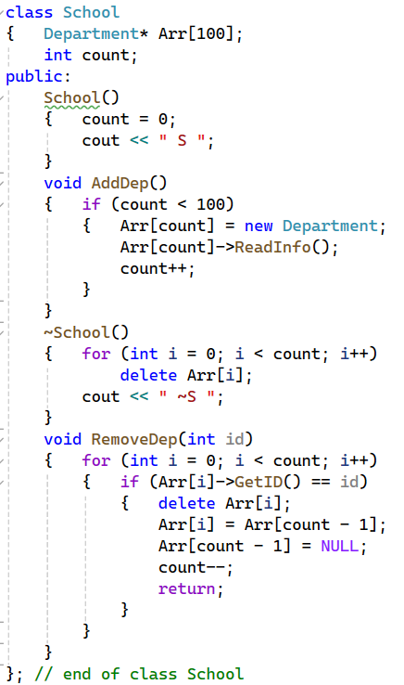
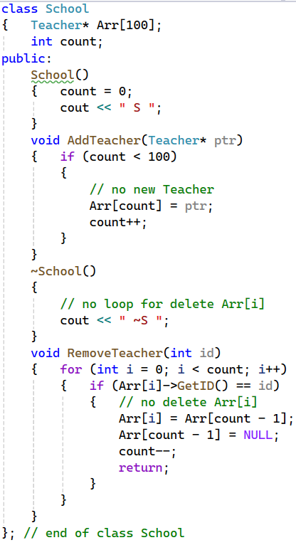
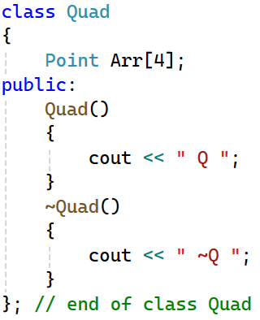
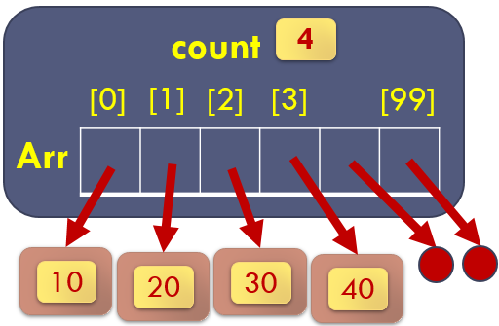
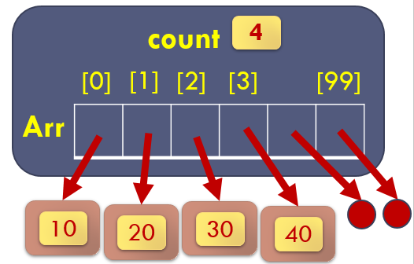
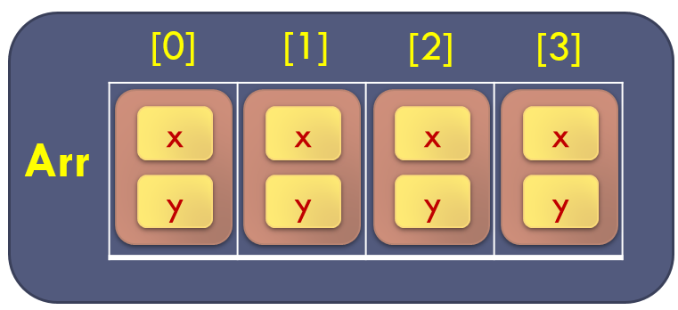
Composition
Aggregation
Association

Slide 24
Comparison (Single Vs. Array)
 | Composition | Aggregation | Association
Data Members in Single Variable | Object To call: Obj.func() | Pointer To call: Ptr->func() | Pointer To call: Ptr->func()
Data Members in Array Variable | Array of Objects To call: Arr[i].func() | Array of Pointers With new and delete of inner inside the outer To call: Arr[i]->func() | Array of Pointers Without new and delete of inner inside the outer To call: Arr[i]->func()

Slide 25
Composition (Single Vs. Array)

Slide 26
Aggregation (Single Vs. Array)

Slide 27
Association (Single Vs. Array)

Slide 28
Non-Default Constructor in Composition
In Composition, we use array of Objects automatically allocated.
So, we create multiple objects at the same time.
So, the inner class MUST have a default constructor.
You can change the data members of the inner class objects later using setters or read info.
Note: in Aggregation and Association, it is the same as explained in Single Variable since we create one object a time.

Slide 29
Thank you

